Slide 1
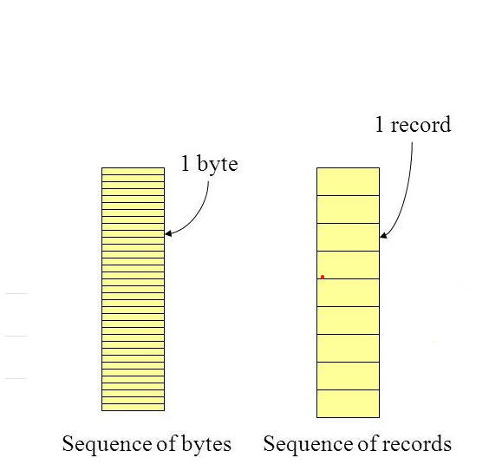
File Concept
File is a sequence of bits, bytes, lines, or records, the meaning of which is defined by the file’s creator and user.
Notes:
3

Slide 2
File Attributes
Name – Name is usually a string of characters
Identifier – unique tag (number) identifies file within file system
Type – needed for systems that support different types
Location – pointer to file location on device
Size – current file size
Protection – Access Permissions, controls who can do reading, writing, executing
Time, date – data for usage monitoring
Notes:
4

Slide 3
File Operations
All operations involve some system calls
1. Create: using a specific system call.
Two steps are necessary to create a file.
Space in the file system must be found for the file.
An entry for the new file must be made in the directory.
2. Read:
Open a file
File pointer points to particular record to be read
Once a record/character is read, the file pointer is increment.
Notes:
5

Slide 4
File Operations
3. Write:
Pointer is at the end of the file
Can be repositioned and is incremented after every write
4. Delete
5. Truncate
Notes:
6

Slide 5
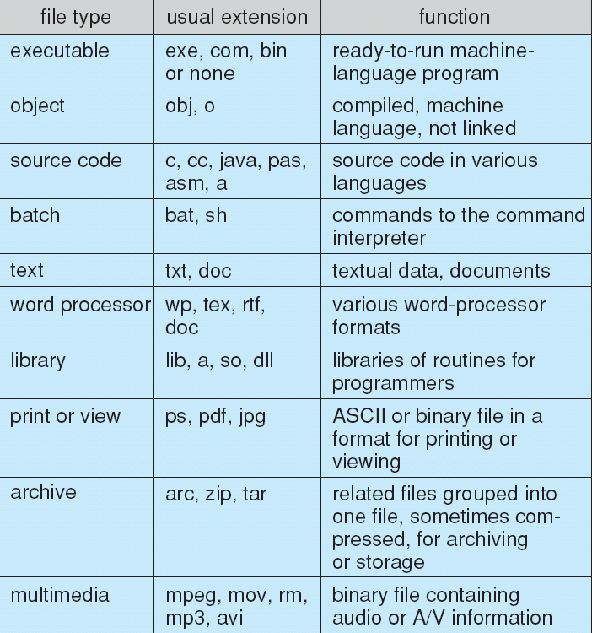
File Types – Name, Extension
Notes:
7

Slide 6
Criteria for File Organization
Economy of Storage
There should be minimum redundancy in data
Redundancy can be used to speed up the access
2. Simple
3. Maintenance
4. Reliability

Slide 7
File System
It is a part of OS, responsible for controlling secondary storage space.
File system consists of following:
Access Methods: Manner in which data stored in files is accessed
Storage Management: Allocating space for files on secondary storage devices.
File Management: Provide mechanism for files to be stored, shared and secured.
File Integrity Mechanism: Guaranteeing that file information is not corrupted
Notes:
9

Slide 8
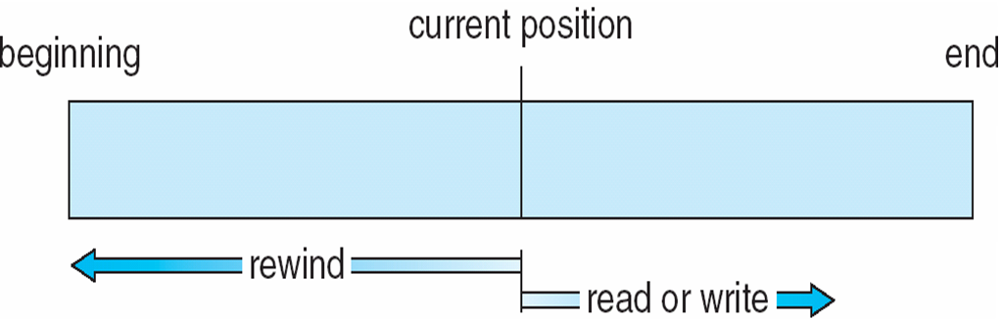
Access Methods
1. Sequential Access:
Information of the file is processed in order, one record after the other.
read next: reads a portion of the file (read record) and automatically updates pointer. (move pointer to next location)
write next: Append to end of the file (write and update the pointer)
rewind or reset: to reset the file from beginning
Notes:
10

Slide 9
Access Methods
2. Direct Access: Or Relative access
A file is made up of fixed length logical records that allow programs to read and write records rapidly in no particular order.
For Direct Access, File is a numbered sequence of blocks or records.
read n
write n
position to n (jump to record n)
read next
write next
n = relative block number
Notes:
11

Slide 10
3.Indexed Access
Index is created for file.
Index contain pointers for various blocks of a file.
To find the record in the file, search the index and then use the pointer to access the file directly and to find the desired record.
An indexed file is a computer file with an index that allows easy random access to any record given its file key.
The key must be such that it uniquely identifies a record.
A relative file is a file in which each record is identified by its ordinal position in the file

Slide 11
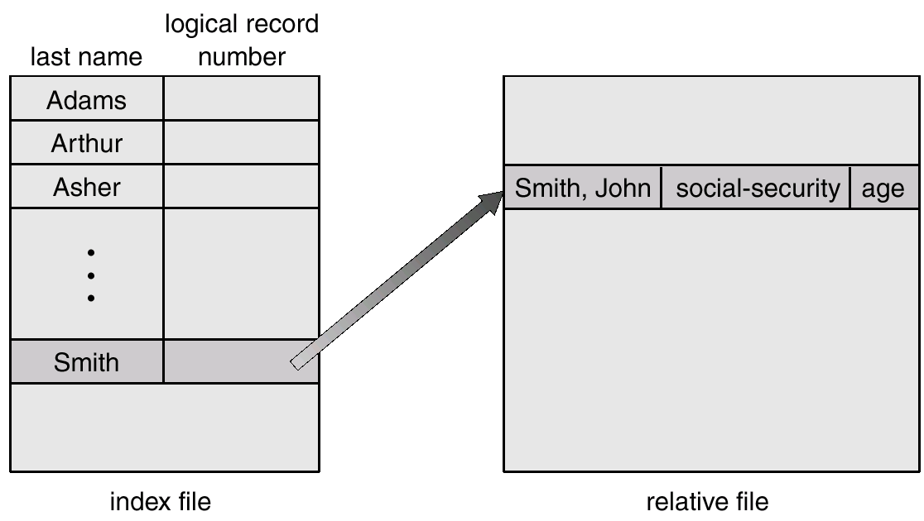
Example of Index and Relative Files
Example of Index and Relative Files

Slide 12
File Management
Allocation methods
Contiguous Allocation
Linked Allocation
Indexed Allocation
Free-Space Management

Slide 13
Allocation Methods
It is the mechanism of keeping track of which disk blocks go which files
Main Issue is: how to allocate space to these files so that disk space is utilized effectively and file can be accessed quickly.
There are three major methods of storing files on disks:
Contiguous
Linked
Indexed
Notes:
15

Slide 14
1. Contiguous Allocation
Store each file as a contiguous block of data on the disk.
Performance is very fast
- Reading successive blocks of the same file generally requires no movement of the disk heads
It is easy to implement
Contiguous allocation of a file is defined by the disk address and length of first block.
Notes:
16

Slide 15
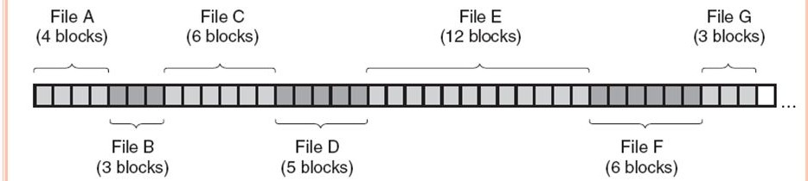
Contiguous Allocation

Slide 16
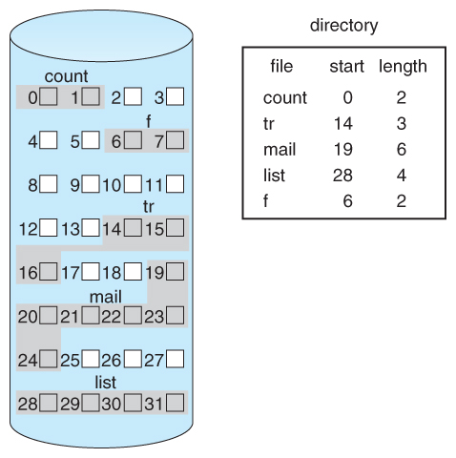
Contiguous Allocation
Problems can arise:
Finding space for a new file
When files grow
If the exact size of a file is unknown at creation time
Suffers from problem of external fragmentation.
Difficult to know how much space is needed for a file
Notes:
18

Slide 17
2. Linked Allocation
Each file is a linked list of disk blocks
Disk blocks can be scattered any where in disk
Directory contains a pointer to first and last block of the file.
Exp: if file of 5 blocks might start at block 9, continue at block 16, then block 1, block 10 and finally block 25.
Each block contains a pointer to next block.
If each block is 512 bytes and disk address requires 4 bytes then user see block of 508 bytes
To create a new file , create a new entry in directory
Each directory has an entry as a pointer to first disk block of file.
Pointer is initialized to NIL and size / data part is set to 0
Notes:
19

Slide 18
Linked Allocation
Disk files can be stored as linked lists
Linked allocation does not require pre-known file sizes and allows files to grow dynamically at any time.
Drawback
It is efficient for sequential access files
To find i^{th} block of a file, we must start at the beginning of that file and follow the pointers until we go to i^{th} block.
Requires extra space for pointers
Problem with linked allocation is reliability:
If a pointer is lost or damaged
Notes:
20

Slide 19
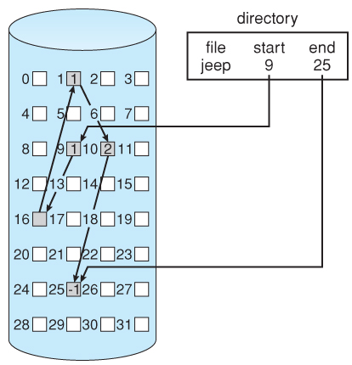
Linked Allocation
Notes:
21

Slide 20
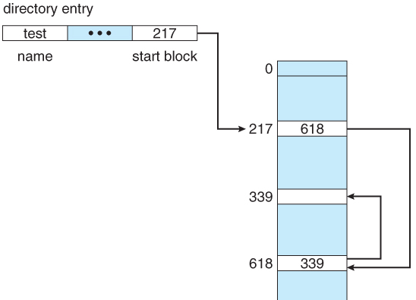
File Allocation Table
Used by DOS
It is a variation of linked allocation
All the links are stored in a separate table at the beginning of the disk.
The benefit of this approach is that the FAT table can be cached in memory, and improving random access speeds.
Notes:
22

Slide 21
3. Indexed Allocation
Indexed Allocation combines all of the indexes for accessing file in a file.
Create a table of indexes
Index file contains pointers to blocks.
Bring all the pointers together into one location : Index Block
Each i^{th} entry in index block points to i^{th} block of the file
Create index of linked locations
Indexed allocation support Direct Access.
Notes:
23

Slide 22
Indexed Allocation
Advantages:
Any free space on the disk can be used for allocation
Removes external fragmentation
Disadvantages:
If index block is small, it will not be able to hold enough pointers
Entire index will have to be kept in main memory to make it work
Notes:
24

Slide 23
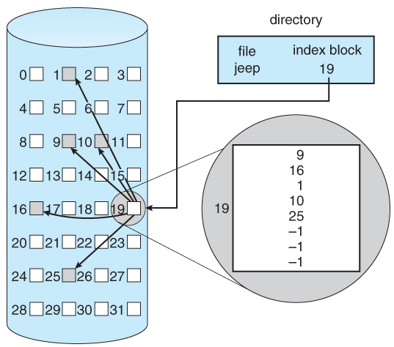
Indexed Allocation
Notes:
25

Slide 24
Approaches to implement Index Block
For large files several indexes can be combined and maintained.
The first index block contains:
Header information
First N block addresses
Pointer to linked index blocks.
Multi-Level Index -
index block contains → pointers to secondary index blocks → which further contain pointers to the actual data blocks.
Notes:
26

Slide 25
Approaches to implement Index Block
Combined Scheme -
pointers provide access to more data blocks
The advantage of this scheme:
for small files the data blocks are readily accessible
Notes:
27

Slide 26
Free Space Management
Notes:
28

Slide 27
Free Space Management
Process of looking after and managing unused blocks of disk
OS maintains free space list: which records all blocks that are not allocated to any file
Methods to implement free space list:
Bit Map or Bit Vector
Linked List
Grouping
Counting
Notes:
29

Slide 28
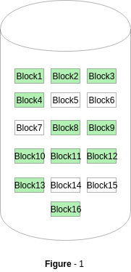
Bit Map or Bit Vector
A Bitmap or Bit Vector is series or collection of bits where each bit corresponds to a disk block.
The bit can take two values: 0 and 1: 0 indicates that the block is allocated and 1 indicates a free block
Figure 1 (where green blocks are allocated) can be represented by a bitmap of 16 bits as: 0000111000000110.
Notes:
30

Slide 29
Bit Map or Bit Vector
Find the location of the first free block.
(number of bits per word) x (number of 0-value words) + offset of first 1 bit.
Notes:
31

Slide 30
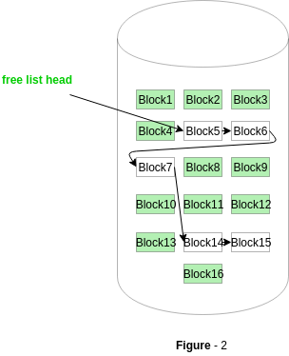
Linked List
Notes:
32

Slide 31

Linked List
Linked list of all the free blocks is maintained
First free block in the list can be pointed by the head pointer
Disadvantage: Traversing is time consuming
Notes:
33

Slide 32
Grouping
This approach stores the address of the free blocks in the first free block.
The first free block stores the address of some, say n free blocks.
Out of these n blocks, the first n-1 blocks are actually free and the last block contains the address of next free n blocks.
Notes:
34

Slide 33
Counting
This approach stores the address of the first free disk block and a number n of free contiguous disk blocks that follow the first block.
Every entry in the list would contain:
Address of first free disk block
A number n
Notes:
35

Slide 34
Implementing File-System
Notes:
36

Slide 35
File System Structure
File System resides on Secondary Storage
Disk provides bulk storage on which a file system resides
To improve I/O efficiency, I/O transfers between memory and disk are performed in units of blocks.
File system has 2 design problems:
a) Defining How the file system should look to user
b) Create an algorithm and data structure to map the logical file system to physical file system.
Notes:
37

Slide 36
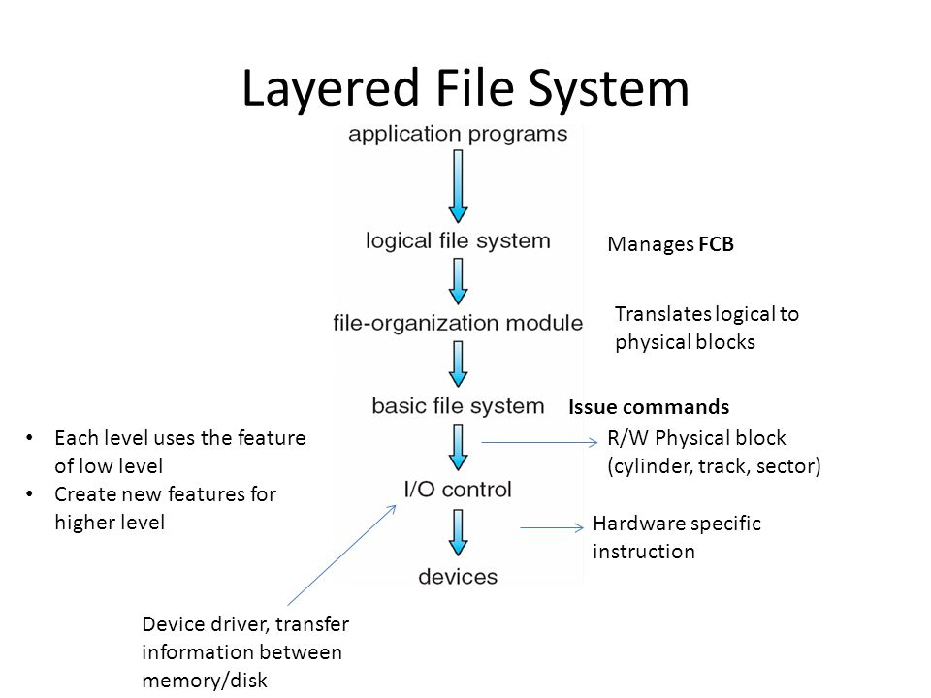
Logical File System contains info. Meta Data, and manages file structure
Notes:
38

Slide 37
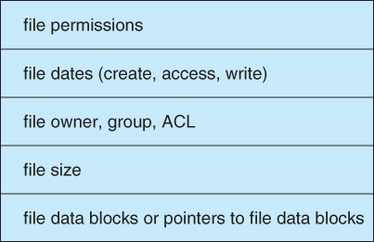
File Control Block
Notes:
39

Slide 38
File System Implementation
On disk, file System may contain information about
a) Boot Control Block: Contains info. Needed by the system to boot an OS. This block is empty if there is no OS.
b) Volume Control Block: Contain partition details:
No. of blocks in partition
Size of blocks
Block pointers etc.
c) Directory Structure: Used to organize files
d) File Control Block: Contains info. About file:
File Permissions
Modification dates
File owner, File size and Pointers
Notes:
40

Slide 39
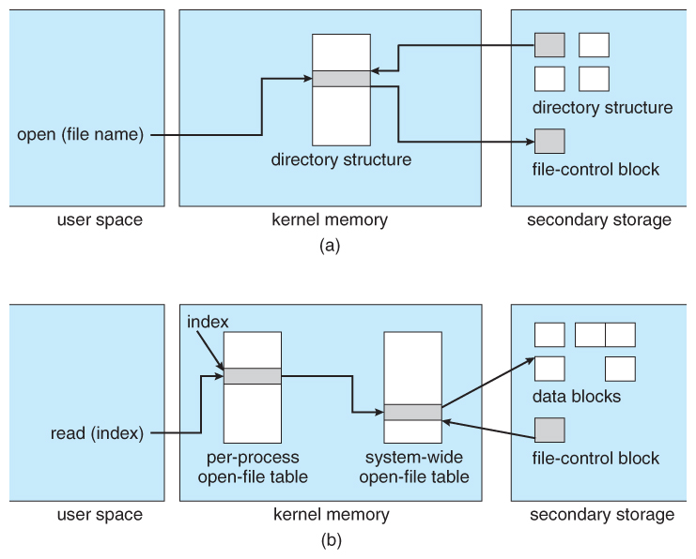
In-memory file-system structures. (a) File open. (b) File read.
Notes:
41

Slide 40
Directory Structure
A collection of nodes containing information about all files.
Directory
Files
F 1
F 2
F 3
F 4
F n
Both the directory structure and the files reside on disk.
Backups of these two structures are kept on tapes.

Slide 41
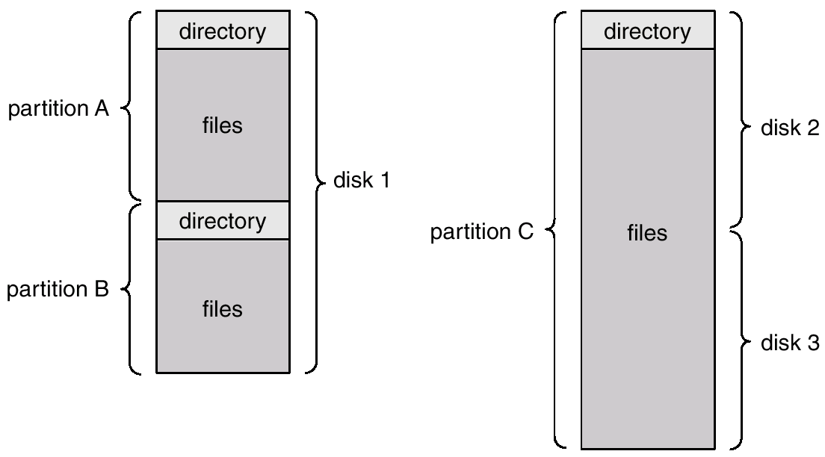

Slide 42
Operations Performed on Directory
Directory: collection of files or directories
A Symbol Table that translates file names into their directory entry.
Operations:
Search for a file
Create a file
Delete a file
List a directory
Rename a file
Traverse the file system : Search all directories/ sub directories and files
Notes:
45

Slide 43
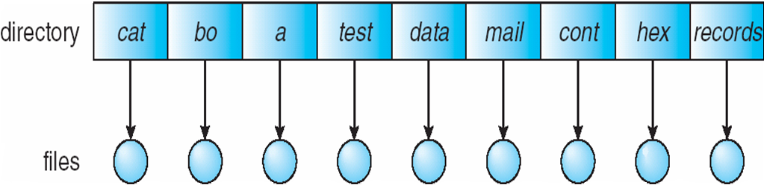
Directory Schemes
Single Level Directory
One directory many files
Single-Level Directory
Easy to support and understand.
Limitation:
When number of files increases or when the system has more than one user, then Naming problem occurs. All files should have unique names.
Disadvantage:
Difficult to remember the name of files when files increases
Single directory for all users
File names created by different users should be different.
Notes:
46

Slide 44
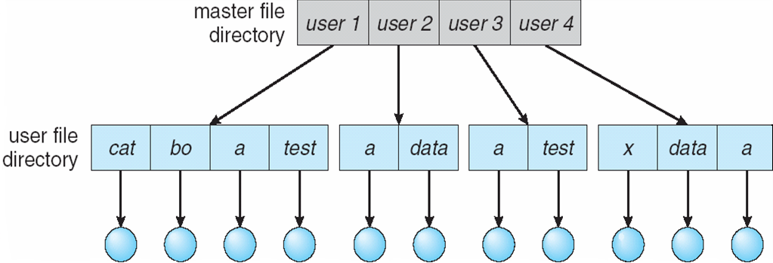
Two Level
2. Two level directory, each user has his own user file directory(UFD).
UFDs have the similar structure, but each lists files of a single user.
Notes:
47

Slide 45
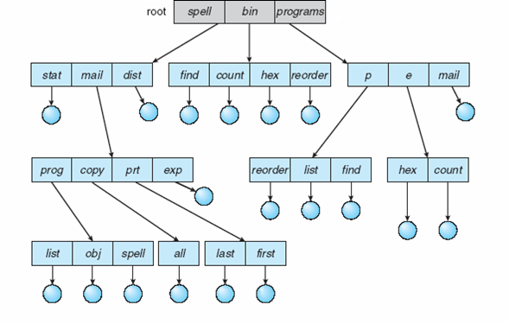
Tree Structure
Users can create their sub directories to manage the files.
Three has Root directory and files have unique file names
Notes:
48

Slide 46
Acyclic-Graph Directories
Multiple users can Have shared subdirectories and files
Users have their own working directory and may have one shared directory
Shared subdirectory created by one user in one directory is automatically visible to all users sharing that directory.
Shared directory or file may exist at multiple places simultaneously
Because of sharing, a file may have multiple absolute paths
So different names can refer to same file
Notes:
49

Slide 47
Acyclic-Graph Directories
These kind of directory graphs can be made using links.
Links can either be symbolic (logical) or hard link (physical).
If a file gets deleted then,
In case of soft link , the file just gets deleted, and we are left with a dangling pointers.
In case of hard link, the actual file will be deleted only if all the references to it gets deleted.
Notes:
50

Slide 48
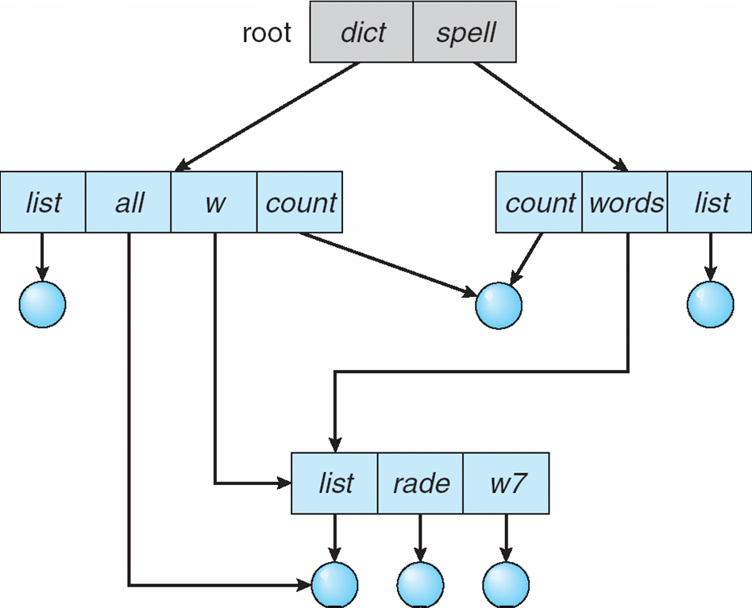
Acyclic-Graph Directories
Notes:
51

Slide 49
General Graph Directories
Cycles are allowed within a directory structure where multiple directories can be derived from more than one parent directory.
The main problem with this kind of directory structure is to calculate the total size or space that has been taken by the files and directories.

Slide 50
General Graph Directories
Advantages:
It allows cycles.
It is more flexible than other directory's structure.
Disadvantages:
It is more costly than others.
It needs garbage collection.

Slide 51
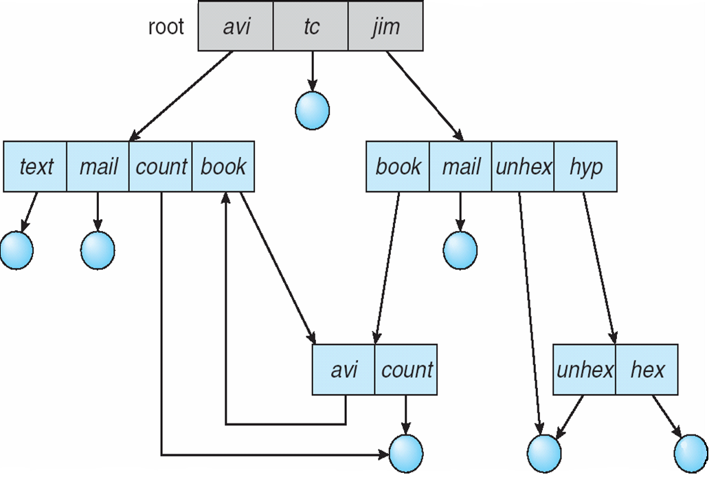
General Graph Directories
There can be cycle in the directory arrangement
General Graph Directory
Notes:
54

Slide 52
Directory Implementation
Notes:
55

Slide 53
Directory Implementation
There is the number of algorithms by using which, the directories can be implemented.
The selection of an appropriate directory implementation algorithm may significantly affect the performance of the system.
Directories need to be fast to search, insert, and delete, with a minimum of wasted disk space.
Two methods
Linear List
Hash Table
Notes:
56

Slide 54
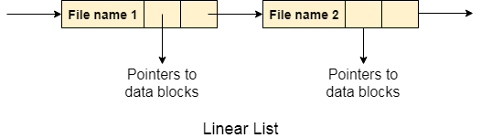
Directory Implementation
Linear List
all the files in a directory are maintained as singly lined list.
Each file contains the pointers to the data blocks which are assigned to it and the next file in the directory.
Notes:
57

Slide 55
Directory Implementation
Linear List
When a new file is created, then the entire list is checked whether the new file name is matching to an existing file name or not.
In case, it doesn't exist, the file can be created at the beginning or at the end.
Therefore, searching for a unique name is a big concern because traversing the whole list takes time
Notes:
58

Slide 56
Directory Implementation
2. Hash Table
This approach uses hash table along with the linked lists.
A key-value pair for each file in the directory gets generated and stored in the hash table.
The key can be determined by applying the hash function on the file name while the key points to the corresponding file stored in the directory.
Notes:
59

Slide 57
Directory Implementation
2. Hash Table
This approach uses hash table along with the linked lists.
A key-value pair for each file in the directory gets generated and stored in the hash table.
The key can be determined by applying the hash function on the file name while the key points to the corresponding file stored in the directory.
Notes:
60

Slide 58
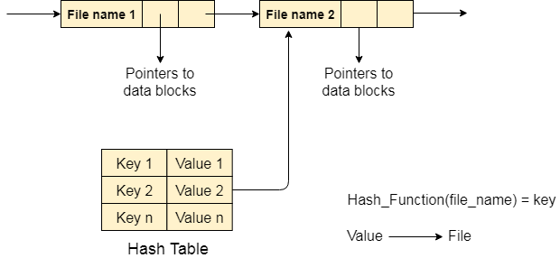
Directory Implementation
2. Hash Table
Notes:
61

Slide 59
Directory Implementation
2. Hash Table
Searching becomes efficient due to the fact that now, entire list will not be searched on every operating.
Only hash table entries are checked using the key and if an entry found then the corresponding file will be fetched using the value.
Notes:
62

